Slide 1
A3 Templates
Self Organising Team Changes

Slide 2
A3 Problem Solving
Background
Countermeasures
Current Condition
Goals
Confirmation: What is your definition of done?
Follow up: contingency if things don’t work out?
Root Cause Analysis

Slide 3
A3 Proposal
Background
Plan Details
Current Condition
Proposal
Unresolved Issues
Implementation Schedule
Alternatives

Slide 4
A3 Status Report
Background
Results
Current Condition
Confirmation: What is your definition of done?

Slide 5
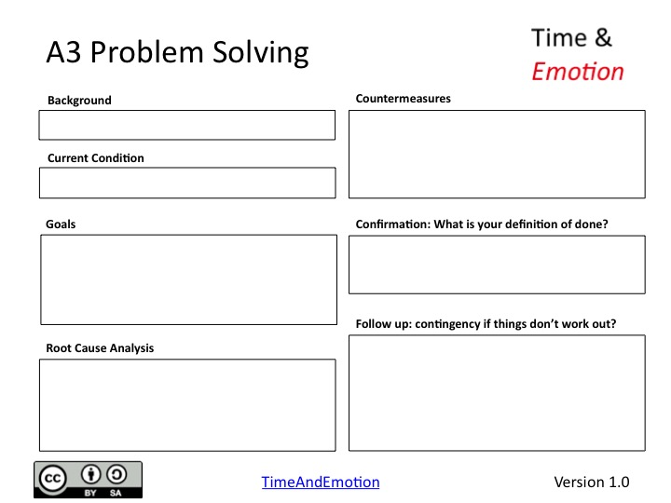
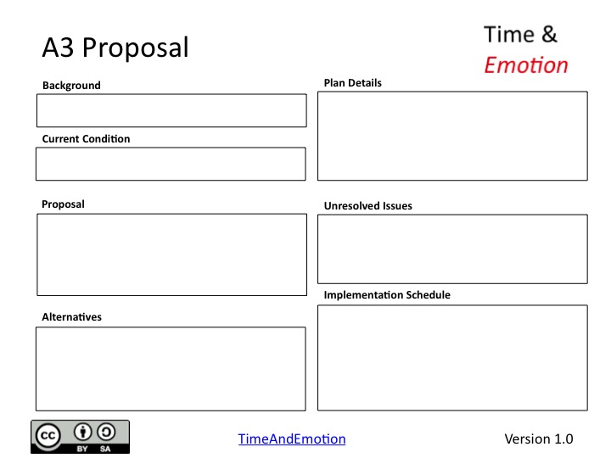
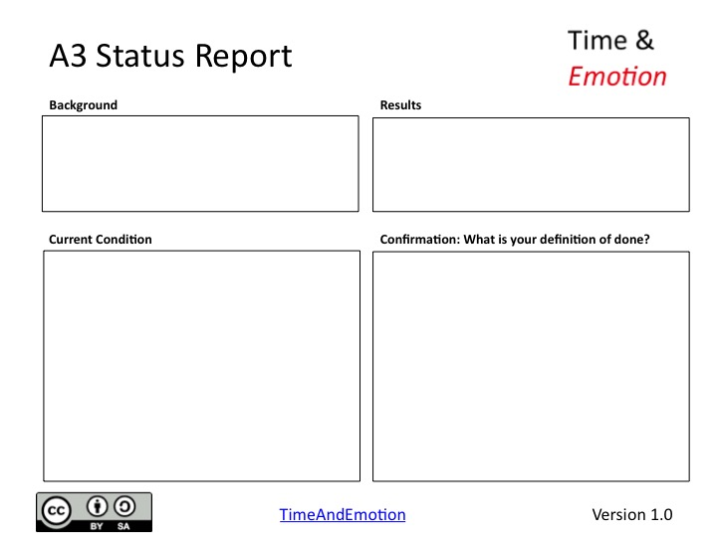
A3 Reporting

